Slide 1
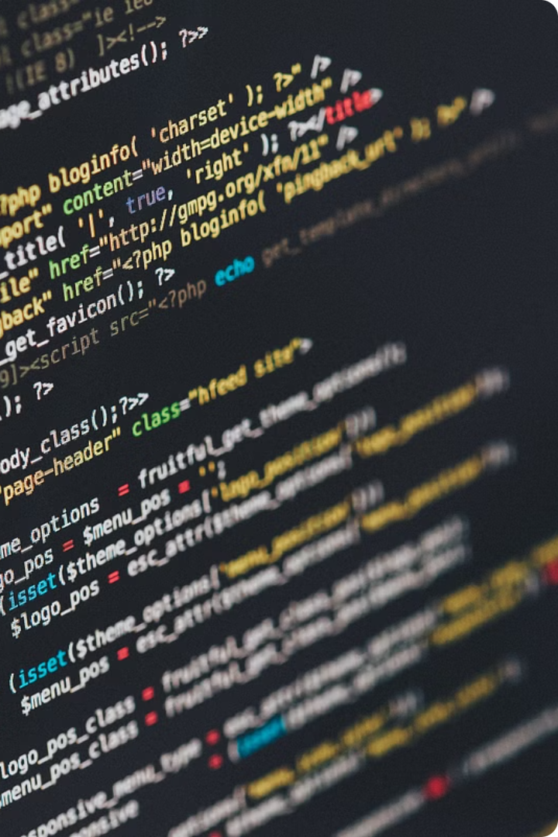
Enhancing The Automation using Summarizer
This capstone study focuses on enhancing automation through the implementation of a text summarizer utilizing Natural Language Processing (NLP) techniques. The study aims to address the growing need for efficient methods to analyze and summarize vast amounts of digital information. This report details the design, implementation, and evaluation of the summarizer, exploring its capabilities and limitations.

Slide 2
Introduction
1
Data Explosion
2
NLP Advancements
The increasing volume of digital information generated daily, driven by social media, blogs, and online news, necessitates efficient methods for analysis and summarization.
Recent advancements in NLP have led to the development of new techniques and algorithms for text analysis and processing, but automatic summarization remains a challenging task due to the complexity of natural language.
3
Study Objectives
4
Real-World Applications
This study aims to design and implement a summarizer based on NLP techniques, evaluate its performance, and analyze its effectiveness in generating summaries of various text types.
Automatic summarization has numerous real-world applications, including news analysis, document retrieval, and text summarization, making it a valuable tool for various industries.

Slide 3

Literature Review
1
Extraction-Based Approach
This approach involves identifying key sentences or phrases in a document and combining them into a summary. While effective in applications like news analysis and document retrieval, it faces challenges in identifying the most important information.
2
Abstraction-Based Approach
This approach generates new sentences or phrases based on the input text, finding applications in text summarization and natural language generation. However, it faces challenges in generating high-quality summary text.
3
Deep Learning Techniques
Recent years have seen a growing interest in using deep learning techniques for automatic summarization. This approach utilizes neural networks to analyze and process text, demonstrating effectiveness in various applications. However, it remains a relatively new area of research requiring further study and development.

Slide 4
Methodologies
Text Preprocessing
Sentence Ranking
Summary Generation
This stage involves tokenizing the input text, removing stop words, porter stemming, and removing punctuation. The goal is to convert the input text into a format suitable for analysis.
This stage involves calculating the TF-IDF scores with respect to the input text and calculating the similarity between sentences using the cosine similarity measure. The goal is to identify the most informative sentences in the document.
This stage involves templating the selected sentences to generate a summary. The goal is to combine the selected sentences into a coherent and informative summary.

Slide 5

Challenges and Future Work
Handling Ambiguity
Threshold Selection
Improving Summary Quality
Natural language is inherently ambiguous, making it challenging to identify the most important information in a document.
The threshold used for selecting the most informative sentences can impact the quality of the summary generated.
The summaries generated by the summarizer need to be high-quality and informative, requiring further research and development.

Slide 6
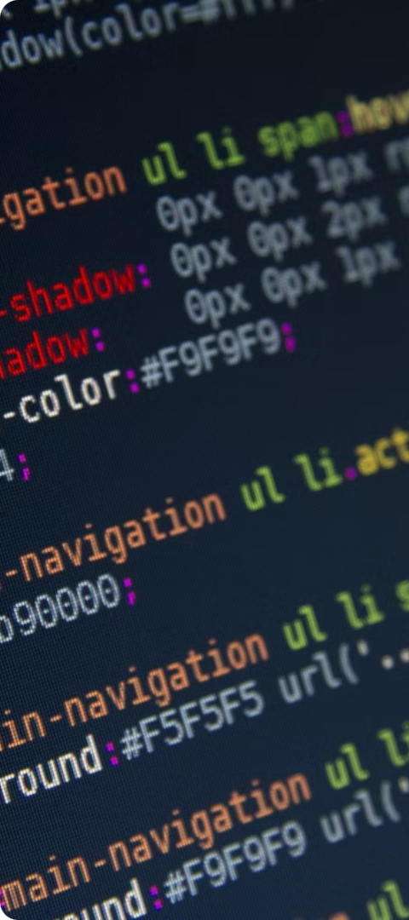



Discussion
Evaluation
The performance of the summarizer was evaluated by comparing it with a baseline summarizer. The results show that the summarizer is able to generate summaries that are generally more accurate and informative than the baseline summarizer.
Limitations
However, there are still limitations to the summarizer's performance, such as the need to handle complex text structures and the need to improve the quality of the summaries generated.
Future Directions
Future work will involve improving the performance of the summarizer and extending the summarization to include other types of input text forms.

Slide 7
Conclusion
In this study, a summarizer based on NLP techniques was designed and implemented.
The summarizer was evaluated by comparing it with a baseline summarizer, which showed that the summarizer is able to generate high-quality summaries.
However, there are still limitations to the summarizer's performance, such as the need to handle complex text structures and the need to improve the quality of the summaries generated.
Future work will involve improving the performance of the summarizer and extending the summarization to include other types of input text forms.

Slide 8




Future Work
Enhanced Summarization Techniques
Multi-document Summarization
Domain-specific Summarization
Evaluation Metrics
Modify the summarizer to handle multiple documents or articles and generate a coherent summary. Investigate methods to integrate information across multiple sources effectively.
Adapt the summarization model to work well with specific domains such as legal texts, medical literature, or scientific studies. Fine-tune pre-trained models on domain-specific datasets to improve performance.
Develop or integrate more sophisticated evaluation metrics beyond ROUGE (Recall-Oriented Understudy for Gisting Evaluation) to better assess the quality of summaries.
Implement and compare different summarization techniques such as extractive, abstractive, and hybrid approaches. Explore advanced neural network architectures like Transformer-based models (e.g., BERT, GPT) for summarization tasks.

